Slide 1
Parents, Grandparents, and caring adults, Welcome to….
Nevada’s live 24/7/365 tip reporting system for
School Safety and Student Well-Being
Anonymous if the reporter chooses to be, always confidential
Empowering Nevada’s students to use their voices to keep their friends, themselves and their schools safe.
Mobile app, Hotline: 1.833.216.7233, www.safevoicenv.org
A Partnership for School Safety
and Student Well-Being

Slide 2
Nevada’s Approach to Tip Reporting Systems
Theory of Change
Safe Schools +
Student Care +
Student Empowerment =
Positive School Climate → Student Success
Bottom Line
SafeVoice is another door in the No Wrong Door approach to school safety & student wellness
When students go through the door, a system of supports is waiting for them

Slide 3
SafeVoice is now a requirement for all public schools per NRS (SB212 of 2017 session), also
WHY bring on SafeVoice?
It’s undeniable, many of our students are facing emotional and mental health challenges, and our schools are faced with threats to student, staff and school safety
SafeVoice is an Early Warning System and a PREVENTION, INTERVENTION, and SUPPORT Tool for the whole school community
The Why: Save lives. Power learning.

Slide 4
Intent: Safety & Well-Being
NDE
Outreach and awareness is Education led
Tip processing is Law Enforcement (DPS) led
Response is from all three partners, including community partners; parental involvement is key
Use of SafeVoice platform to communicate
Partnership supports collaboration
School Districts
Charter Schools
School Police Depts.
School Social Workers & Counselors
DPS
MCRT
Local LE Agencies
Local BH Agencies

Slide 5
The Process
DPS receives reports live 24/7; two way dialogue when reporter logs back in
Active threat of school violence or suicide to law enforcement 24/7
School Team
receives report and responds timely during school hours
Active suicide received to SV hotline bridged to Crisis Call Hotline while LE dispatched

Slide 6
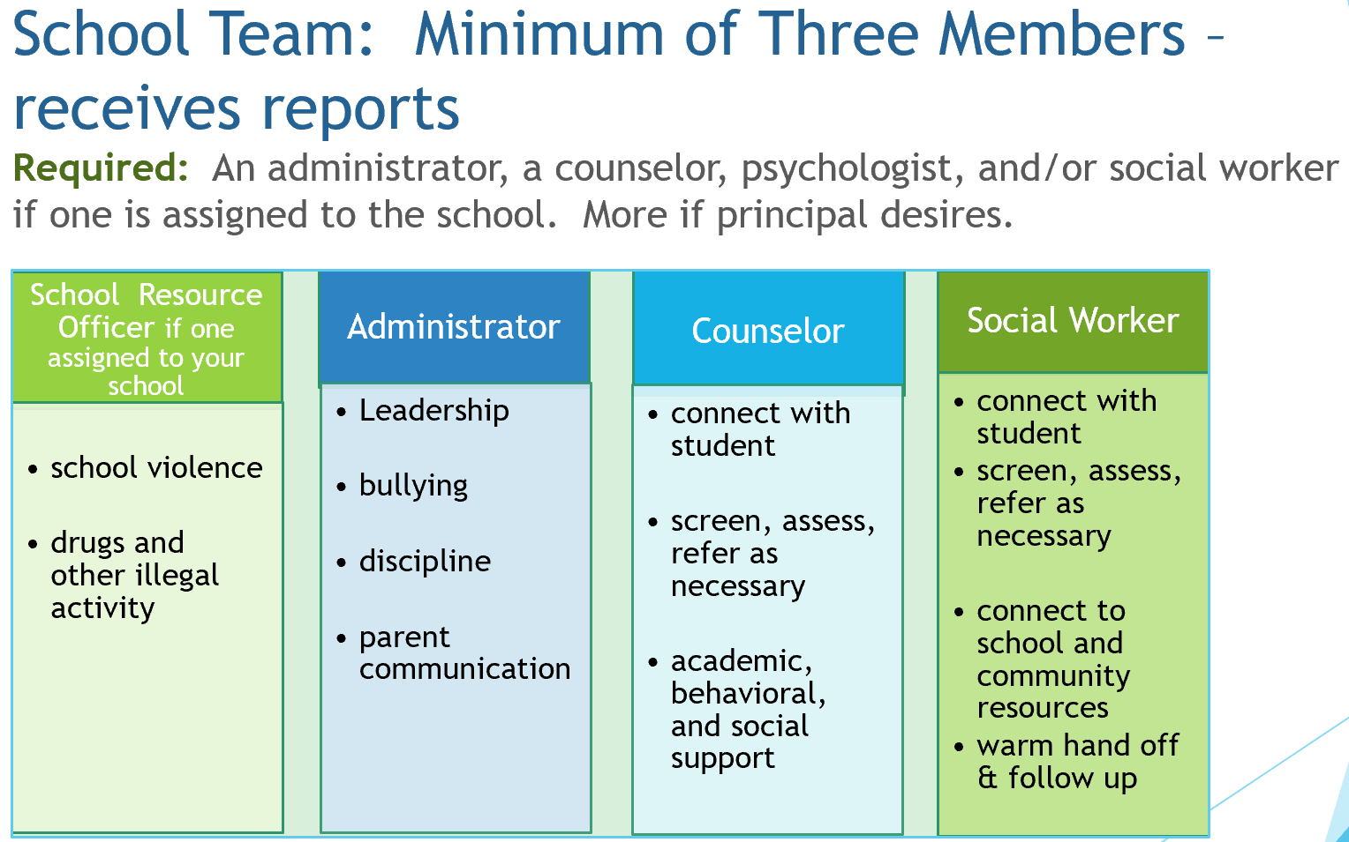

Slide 7
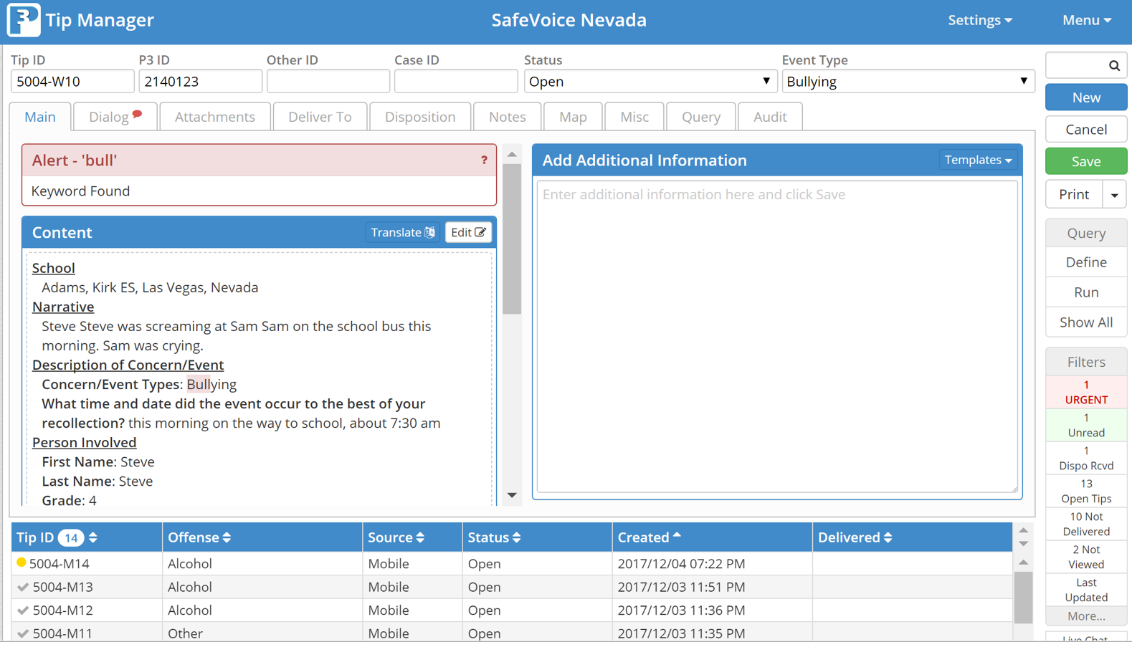
How does it work? REALLY WELL! P3campus.com – team member logs in to see and dispo tips
P3 encrypts reports so reporter is anonymous; phone number, IP address, location are not known. Reporter may choose to share name and contact information to assist in resolving concern, whether it is a self-report or as a witness to an event, or a friend concerned for another friend.

Slide 8
Our ask of you – introduce, remind, reinforce, encourage respectful use
3 ways to report

Slide 9
A word about Appropriate and Respectful
SafeVoice is here to:
It is not for:
Protect students from bullying and school violence
Help students speak up for their friends & themselves
Help parents who have already spoken directly to teachers and principals, yet feel they have not been heard
False reports, peer conflict, or pranks
Complaints and grievances that are not related to school safety and student well-being
These take life saving time from the Comm Center
Harassing other students or adults in the school
False and malicious reporting can cause reporter to void anonymity
Please reinforce these points as you talk with your child about SafeVoice

Slide 10
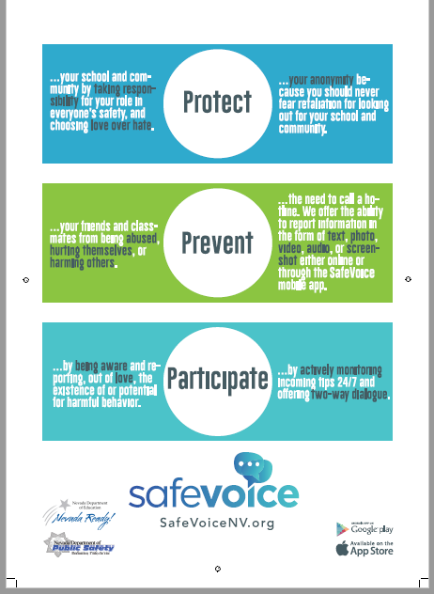
Rack Card,
English and Spanish
Applaud your student(s) for standing up for each other and themselves, for owning school climate and safety.
Where else can we get the community involved?
← Hallway Posters →
Classroom posters

Slide 11
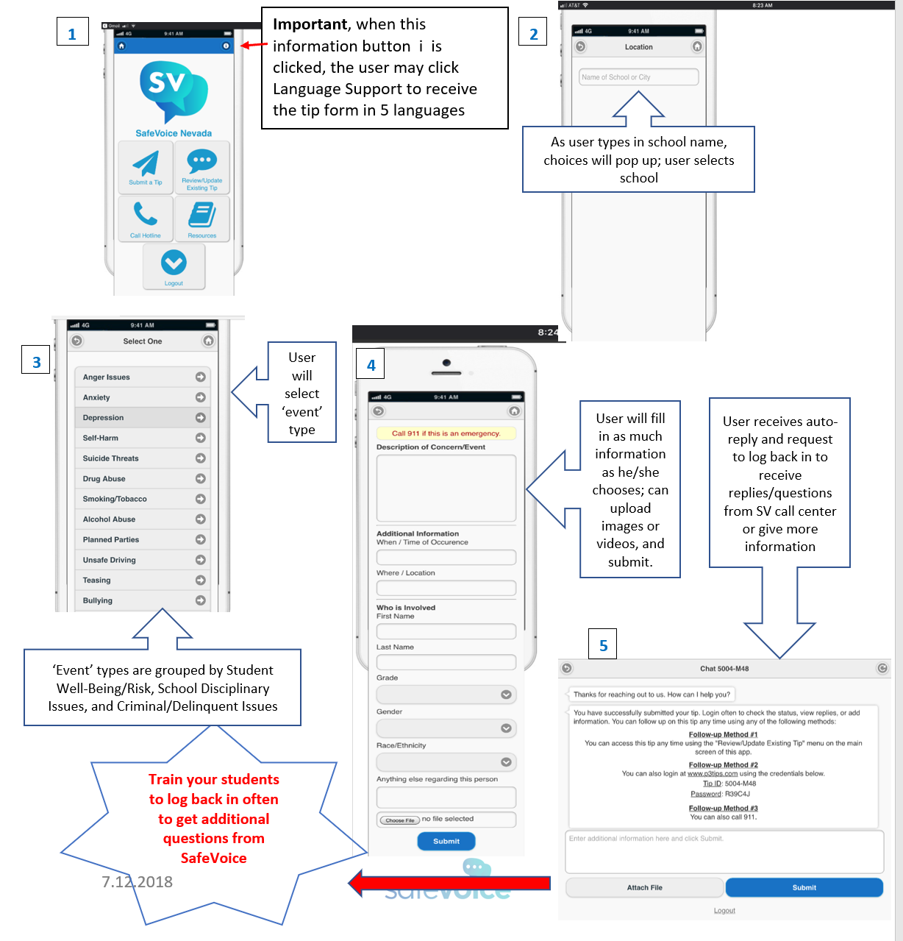
Using the Mobile App
Download from app store – FREE
Click Submit a Tip NOTE: upper right corner language (Spanish) dropdown
Type school name, will auto-populate
Select Event Type
Describe event, more information in drop downs NOTE: student must use name to self report!
Submit and screenshot tip number and password. LOG BACK IN to dialog with DPS

Slide 12
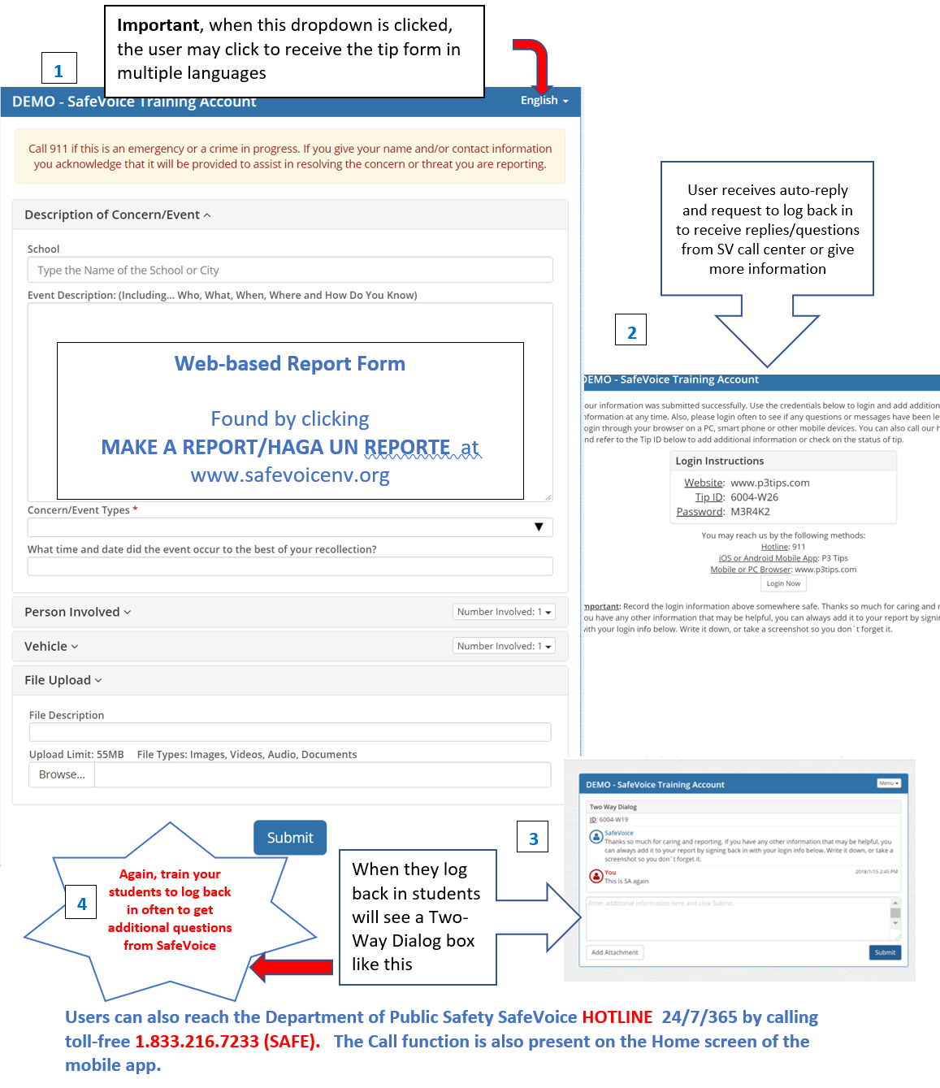
Reporting from www.safevoicenv.org
Same process
Language choices in upper right corner
Log back in (please!) to get questions from DPS Comm Specialist or to give additional information

Slide 13
A message from David King, an Assistant Principle in Colorado about Safe2Tell, which uses the same technology and similar approach as
Thank you! for all the care you share with your child and youth!
https://goo.gl/images/p7f2vk
And finally,

